Slide 1
eatables
eatables
eatables
eatables
eatables
eatables
eatables
eatables
eatables
eatables
eatables
eatables
eatables
eatables
eatables
eatables
eatables
eatables
eatables
eatables
eatables
eatables
eatables
eatables
eatables
eatables
eatables
eatables
eatables
eatables
eatables
204682 – Ashwin K.V
204683 – Darshan Dinesh M.P
204684 – Delbin George
eatables
eatables
eatables
eatables
eatables
eatables
eatables
eatables
eatables
eatables
eatables
eatables
eatables
eatables

Slide 2
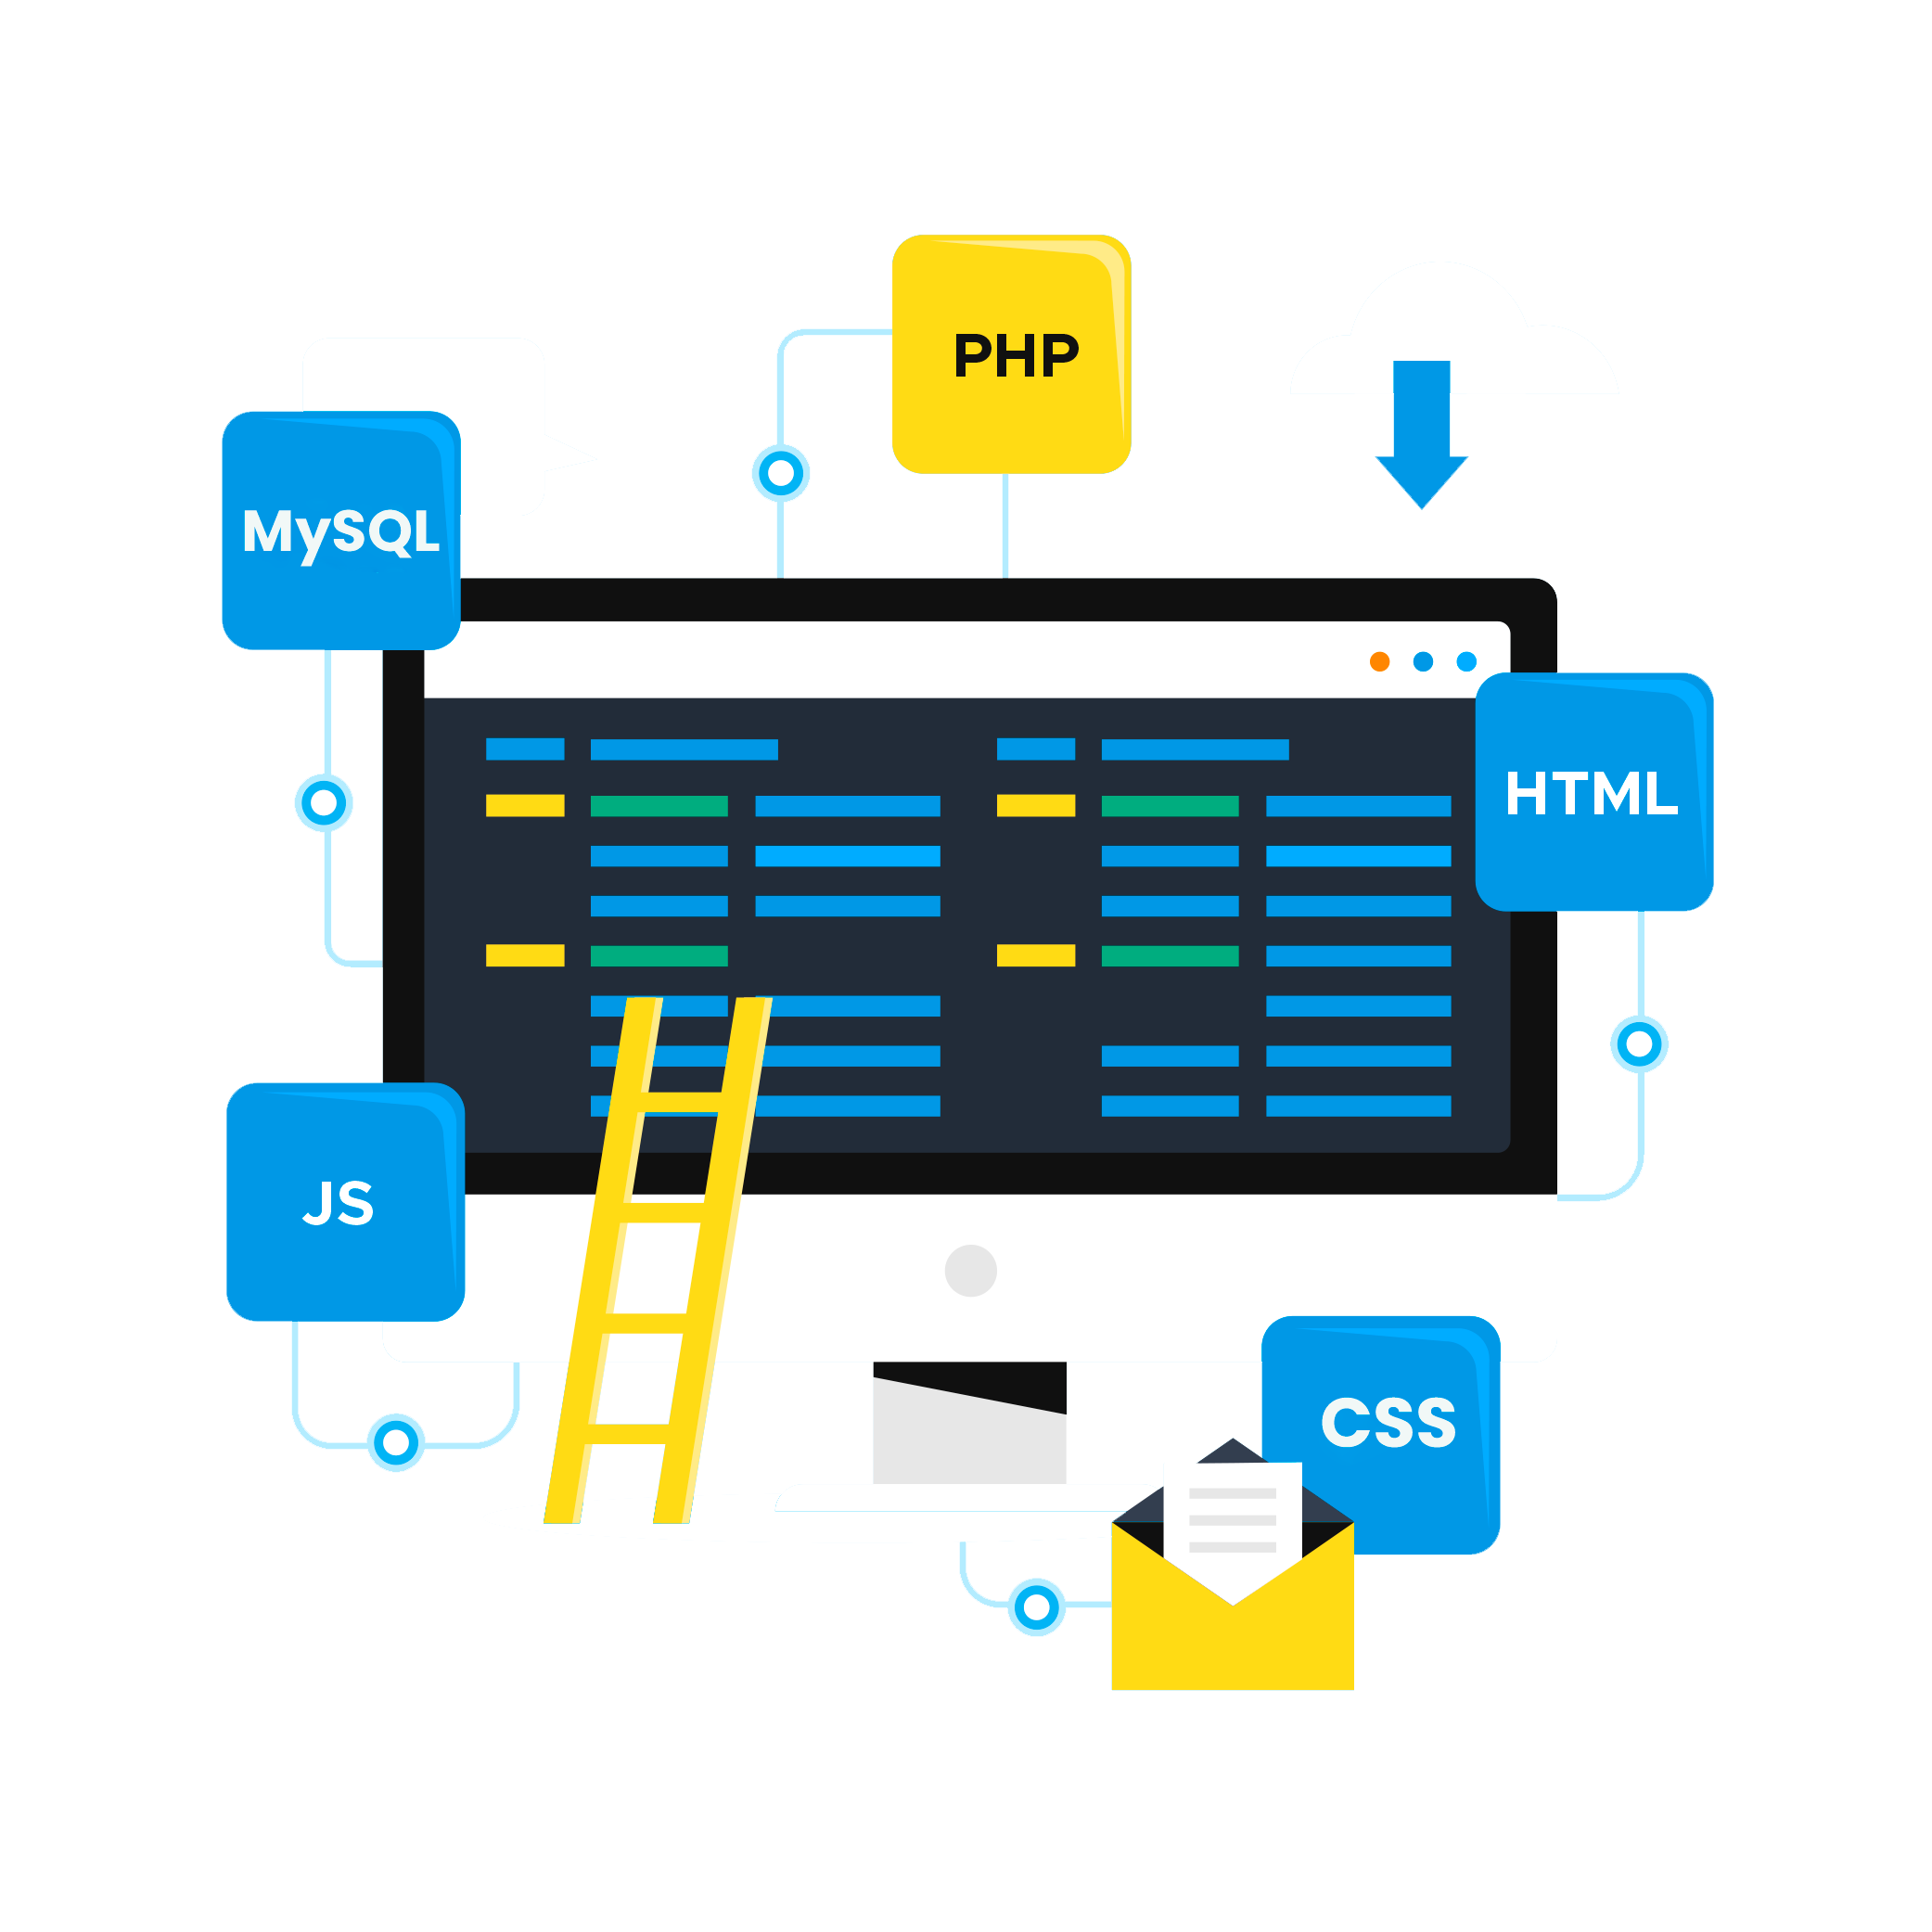


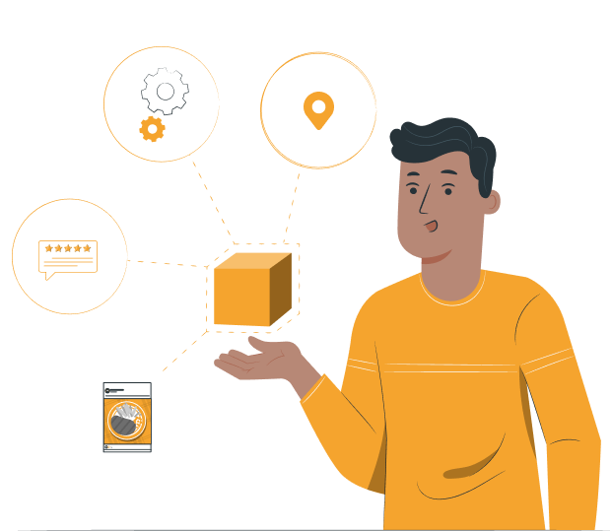
TECHNOLOGY USED
eatables
eatables
eatables
eatables
eatables
eatables
eatables
eatables
eatables
eatables
eatables
eatables
INTRODUCTION
CONCLUSION
eatables
eatables
eatables
eatables
eatables
eatables
eatables
eatables
eatables
eatables
eatables
eatables
eatables
eatables
eatables
eatables
eatables
eatables
eatables
eatables
eatables
204682 – Ashwin K.V
204683 – Darshan Dinesh M.P
204684 – Delbin George
eatables
eatables
eatables
eatables
eatables
eatables
eatables
eatables
eatables
eatables
eatables
eatables
KEY FEATURES

Slide 3
eatables
eatables
eatables
eatables
eatables
eatables
eatables
eatables
eatables
eatables
eatables
eatables
eatables
eatables
eatables
eatables
eatables
EATABLES is a dynamic and user-friendly platform that provides a convenient way for food lovers to discover new dining options. With features like location-based restaurant recommendation, user reviews, personalized favorites lists, vlog uploads, and filtered search results, By creating a community-driven approach, EATABLES fosters engagement and encourages users to share their dining experiences and recommendations with others.
User reviews and ratings for restaurants
Detailed restaurant information, including contact details and address
Personalized favorites list for easy reference
"Drops" feature for users to upload and share food vlog videos
Restaurant submission feature for users to suggest new restaurants
Admin panel for managing restaurant information and review user submitted suggestions
Mobile-friendly platform for easy access on-the-go
eatables
eatables
eatables
eatables
INTRODUCTION
KEY FEATURES
TECHNOLOGY USED
CONCLUSION
eatables
eatables
eatables
eatables
eatables
eatables
eatables
eatables
eatables
eatables
eatables
eatables
eatables
eatables
eatables
eatables
eatables
eatables
eatables
eatables
204682 – Ashwin K.V
204683 – Darshan Dinesh M.P
204684 – Delbin George
eatables
eatables
eatables
eatables

Slide 4
eatables
eatables
eatables
eatables
KEY FEATURES
TECHNOLOGY USED
CONCLUSION
eatables
eatables
eatables
eatables
eatables
INTRODUCTION
eatables
eatables
eatables
eatables
EATABLES is a dynamic and user-friendly platform that provides a convenient way for food lovers to discover new dining options. With features like location-based restaurant recommendation, user reviews, personalized favorites lists, vlog uploads, and filtered search results, By creating a community-driven approach, EATABLES fosters engagement and encourages users to share their dining experiences and recommendations with others.
eatables
eatables
eatables
eatables
eatables
eatables
eatables
eatables
eatables
eatables
eatables
eatables
eatables
eatables
eatables
eatables
eatables
eatables
eatables
eatables
eatables
eatables
eatables
eatables
eatables
eatables
eatables
eatables
eatables
eatables
eatables
eatables

Slide 5
eatables
eatables
eatables
eatables
eatables
eatables
eatables
eatables
eatables
eatables
eatables
eatables
eatables
eatables
eatables
eatables
eatables
EATABLES is a dynamic and user-friendly platform that provides a convenient way for food lovers to discover new dining options. With features like location-based restaurant recommendation, user reviews, personalized favorites lists, vlog uploads, and filtered search results, By creating a community-driven approach, EATABLES fosters engagement and encourages users to share their dining experiences and recommendations with others.
User reviews and ratings for restaurants
Detailed restaurant information, including contact details and address
Personalized favorites list for easy reference
"Drops" feature for users to upload and share food vlog videos
Restaurant submission feature for users to suggest new restaurants
Admin panel for managing restaurant information and review user submitted suggestions
Mobile-friendly platform for easy access on-the-go
INTRODUCTION
KEY FEATURES
TECHNOLOGY USED
CONCLUSION
eatables
eatables
eatables
eatables
eatables
eatables
eatables
eatables
eatables
eatables
eatables
eatables
eatables
eatables
eatables
eatables
eatables
eatables
eatables
eatables
204682 – Ashwin K.V
204683 – Darshan Dinesh M.P
204684 – Delbin George
eatables
eatables
eatables
eatables
eatables
eatables
eatables
eatables

Slide 6
eatables
eatables
eatables
eatables
eatables
eatables
eatables
eatables
eatables
eatables
eatables
eatables
eatables
eatables
eatables
eatables
eatables
EATABLES is a dynamic and user-friendly platform that provides a convenient way for food lovers to discover new dining options. With features like location-based restaurant recommendation, user reviews, personalized favorites lists, vlog uploads, and filtered search results, By creating a community-driven approach, EATABLES fosters engagement and encourages users to share their dining experiences and recommendations with others.
User reviews and ratings for restaurants
Detailed restaurant information, including menu, contact details and address
Personalized favorites list for easy reference
"Drops" feature for users to upload and share food vlog videos
Restaurant submission feature for users to suggest new restaurants
Admin panel for managing restaurant information and review user submitted suggestions
Mobile-friendly platform for easy access on-the-go
INTRODUCTION
KEY FEATURES
TECHNOLOGY USED
CONCLUSION
eatables
eatables
eatables
eatables
eatables
eatables
eatables
eatables
eatables
eatables
eatables
eatables
eatables
eatables
eatables
eatables
eatables
eatables
eatables
eatables
204682 – Ashwin K.V
204683 – Darshan Dinesh M.P
204684 – Delbin George
eatables
eatables
eatables
eatables
eatables
eatables
eatables
eatables

Slide 7
eatables
eatables
eatables
eatables
eatables
eatables
eatables
eatables
INTRODUCTION
TECHNOLOGY USED
CONCLUSION
eatables
eatables
eatables
eatables
eatables
KEY FEATURES
eatables
eatables
eatables
eatables
eatables
eatables
eatables
User reviews and ratings for restaurants
Detailed restaurant information, including menu, contact details and address
Personalized favorites list for easy reference
"Drops" feature for users to upload and share food vlog videos
Restaurant submission feature for users to suggest new restaurants
Admin panel for managing restaurant information and review user submitted suggestions
Mobile-friendly platform for easy access on-the-go
eatables
eatables
eatables
eatables
eatables
eatables
eatables
eatables
eatables
eatables
eatables
eatables
eatables
eatables
eatables
eatables
eatables
eatables
eatables
eatables
eatables
eatables
eatables
eatables
eatables

Slide 8
eatables
eatables
eatables
eatables
eatables
eatables
eatables
eatables
eatables
eatables
eatables
eatables
eatables
User reviews and ratings for restaurants
Detailed restaurant information, including menu, contact details and address
Personalized favorites list for easy reference
"Drops" feature for users to upload and share food vlog videos
Restaurant submission feature for users to suggest new restaurants
Admin panel for managing restaurant information and review user submitted suggestions
Mobile-friendly platform for easy access on-the-go
eatables
eatables
eatables
eatables
INTRODUCTION
KEY FEATURES
TECHNOLOGY USED
CONCLUSION
eatables
eatables
eatables
eatables
eatables
eatables
eatables
eatables
eatables
eatables
eatables
eatables
eatables
eatables
eatables
eatables
eatables
eatables
eatables
eatables
204682 – Ashwin K.V
204683 – Darshan Dinesh M.P
204684 – Delbin George
eatables
eatables
eatables
eatables
eatables
eatables
eatables
eatables

Slide 9
eatables
eatables
eatables
eatables
eatables
eatables
eatables
eatables
eatables
eatables
eatables
eatables
eatables
User reviews and ratings for restaurants
Detailed restaurant information, including contact details and address
Personalized favorites list for easy reference
"Drops" feature for users to upload and share food vlog videos
Restaurant submission feature for users to suggest new restaurants
Admin panel for managing restaurant information and review user submitted suggestions
Mobile-friendly platform for easy access on-the-go
eatables
eatables
eatables
eatables
Our platform is built using HTML, JavaScript, and Tailwind CSS for the frontend, and PHP and MySQL for the backend. This powerful combination of technologies ensures that our platform is user-friendly, responsive, and efficient.
We integrated the Geolocation API to retrieve the user's location and provide location-based recommendations.
INTRODUCTION
KEY FEATURES
TECHNOLOGY USED
CONCLUSION
eatables
eatables
eatables
eatables
eatables
eatables
eatables
eatables
eatables
eatables
eatables
eatables
eatables
eatables
eatables
eatables
eatables
eatables
eatables
eatables
204682 – Ashwin K.V
204683 – Darshan Dinesh M.P
204684 – Delbin George
eatables
eatables
eatables
eatables
eatables
eatables
eatables
eatables

Slide 10
CONCLUSION
INTRODUCTION
KEY FEATURES
eatables
eatables
eatables
eatables
eatables
TECHNOLOGY USED
eatables
eatables
eatables
eatables
Our platform is built using HTML, JavaScript, and Tailwind CSS for the frontend, and PHP and MySQL for the backend. This powerful combination of technologies ensures that our platform is user-friendly, responsive, and efficient.
We integrated the Geolocation API to retrieve the user's location and provide location-based recommendations.
eatables
eatables
eatables
eatables
eatables
eatables
eatables
eatables
eatables
eatables
eatables
eatables
eatables
eatables
eatables
eatables
eatables
eatables
eatables
eatables
eatables
eatables
eatables
eatables
eatables
eatables
eatables
eatables
eatables
eatables
eatables
eatables
eatables
eatables
eatables
eatables

Slide 11
eatables
eatables
eatables
eatables
eatables
eatables
eatables
eatables
eatables
eatables
eatables
eatables
eatables
eatables
eatables
eatables
eatables
Our platform is built using HTML, JavaScript, and Tailwind CSS for the frontend, and PHP and MySQL for the backend. This powerful combination of technologies ensures that our platform is user-friendly, responsive, and efficient.
We integrated the Geolocation API to retrieve the user's location and provide location-based recommendations.
eatables
eatables
eatables
KEY FEATURES
CONCLUSION
INTRODUCTION
eatables
TECHNOLOGY USED
eatables
eatables
eatables
eatables
eatables
eatables
eatables
eatables
eatables
eatables
eatables
eatables
eatables
eatables
eatables
eatables
eatables
eatables
204682 – Ashwin K.V
204683 – Darshan Dinesh M.P
204684 – Delbin George
eatables
eatables
eatables
eatables
eatables
eatables

Slide 12
eatables
eatables
eatables
eatables
eatables
eatables
eatables
eatables
eatables
eatables
eatables
eatables
eatables
eatables
eatables
eatables
eatables
User reviews and ratings for restaurants
Detailed restaurant information, including contact details and address
Personalized favorites list for easy reference
"Drops" feature for users to upload and share food vlog videos
Restaurant submission feature for users to suggest new restaurants
Admin panel for managing restaurant information and review user submitted suggestions
Mobile-friendly platform for easy access on-the-go
Our platform is built using HTML, JavaScript, and Tailwind CSS for the frontend, and PHP and MySQL for the backend. This powerful combination of technologies ensures that our platform is user-friendly, responsive, and efficient.
We integrated the Geolocation API to retrieve the user's location and provide location-based recommendations.
eatables
eatables
eatables
KEY FEATURES
CONCLUSION
INTRODUCTION
eatables
TECHNOLOGY USED
eatables
eatables
eatables
eatables
eatables
eatables
eatables
eatables
eatables
eatables
eatables
eatables
eatables
eatables
eatables
eatables
eatables
eatables
204682 – Ashwin K.V
204683 – Darshan Dinesh M.P
204684 – Delbin George
eatables
eatables
eatables
eatables
eatables
eatables
EATABLES is a user-friendly platform that offers a seamless dining experience, providing users with a one-stop solution for exploring new food options. The platform's innovative features, including geolocation-based restaurant suggestions, community-driven reviews, and personalized favorites lists, make it easy for users to find the perfect dining spot based on their preferences. With its user-centric design and advanced technology, EATABLES is the ultimate tool for anyone looking to discover new culinary delights.

Slide 13
INTRODUCTION
KEY FEATURES
TECHNOLOGY USED
eatables
eatables
eatables
eatables
eatables
eatables
eatables
eatables
eatables
CONCLUSION
eatables
eatables
eatables
eatables
EATABLES is a user-friendly platform that offers a seamless dining experience, providing users with a one-stop solution for exploring new food options. The platform's innovative features, including geolocation-based restaurant suggestions, community-driven reviews, and personalized favorites lists, make it easy for users to find the perfect dining spot based on their preferences. With its user-centric design and advanced technology, EATABLES is the ultimate tool for anyone looking to discover new culinary delights.
eatables
eatables
eatables
eatables
eatables
eatables
eatables
eatables
eatables
eatables
eatables
eatables
eatables
eatables
eatables
eatables
eatables
eatables
eatables
eatables
eatables
eatables
eatables
eatables
eatables
eatables
eatables
eatables
eatables
eatables
eatables
eatables

Slide 14


eatables
eatables
eatables
eatables
eatables
eatables
eatables
eatables
eatables
eatables
eatables
eatables
eatables
User reviews and ratings for restaurants
Detailed restaurant information, including contact details and address
Personalized favorites list for easy reference
"Drops" feature for users to upload and share food vlog videos
Restaurant submission feature for users to suggest new restaurants
Admin panel for managing restaurant information and review user submitted suggestions
Mobile-friendly platform for easy access on-the-go
Our platform is built using HTML, JavaScript, and Tailwind CSS for the frontend, and PHP and MySQL for the backend. This powerful combination of technologies ensures that our platform is user-friendly, responsive, and efficient.
We integrated the Geolocation API to retrieve the user's location and provide location-based recommendations.
INTRODUCTION
KEY FEATURES
eatables
CONCLUSION
eatables
eatables
TECHNOLOGY USED
eatables
eatables
eatables
eatables
eatables
eatables
eatables
eatables
eatables
eatables
eatables
eatables
eatables
eatables
eatables
eatables
eatables
204682 – Ashwin K.V
204683 – Darshan Dinesh M.P
204684 – Delbin George
eatables
eatables
eatables
eatables
eatables
eatables
eatables
eatables
eatables
eatables
eatables
eatables
EATABLES is a user-friendly platform that offers a seamless dining experience, providing users with a one-stop solution for exploring new food options. The platform's innovative features, including geolocation-based restaurant suggestions, community-driven reviews, and personalized favorites lists, make it easy for users to find the perfect dining spot based on their preferences. With its user-centric design and advanced technology, EATABLES is the ultimate tool for anyone looking to discover new culinary delights.

Slide 15
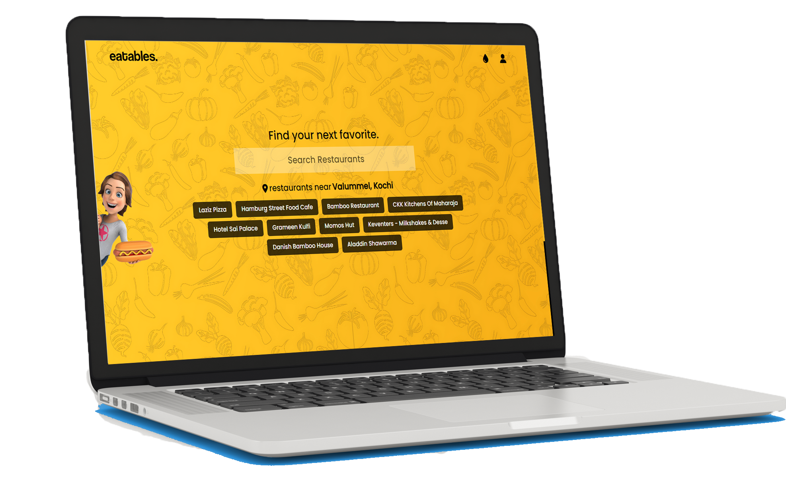
eatables
eatables
eatables
eatables
eatables
eatables
eatables
eatables
eatables
eatables
eatables
eatables
CONCLUSION
INTRODUCTION
eatables
eatables
eatables
eatables
eatables
eatables
eatables
eatables
eatables
eatables
eatables
eatables
eatables
eatables
eatables
eatables
eatables
eatables
eatables
eatables
eatables
eatables
eatables
eatables
eatables
eatables
eatables
eatables
eatables
Lets go.....
eatables
eatables
eatables
eatables
KEY FEATURES
TECHNOLOGY USED

